Slide 1
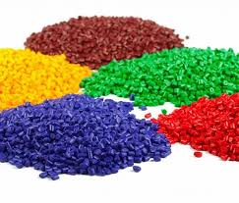
بسم الله الرحمن الرحيم
Advance Polymer Scinces
Dr.Widad .Saleh.Hanoosh

Slide 2
Introduction
Properties of Polymers
- Type of monomers
- The chemical bond between the repeating units—for example, ether vs amide bonds
- Degree of polymerization
- Architecture of the chain—for example, linear or cross-linked
- Incorporation of chemically different monomers along the polymer chains
(copolymerization)
- Sequence of monomers in a copolymerization—for example, alternately or in long
sequences which consist of only one type of monomer .
- Specific interactions between the components of the polymer chain, e.g., hydrogen
bonding or dipole–dipole interactions

Slide 3
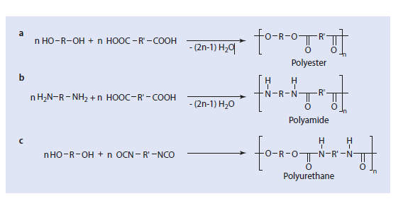
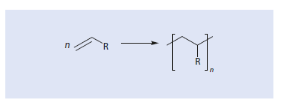
Condensation Polymerization
Addition Polymerization

Slide 4
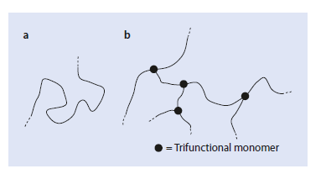
Ring-Opining
Polymerization
Polymer Structures
Fig. 1. Schematic
representation of (a) a linear
polymer chain and
(b) a branched macromolecule

Slide 5
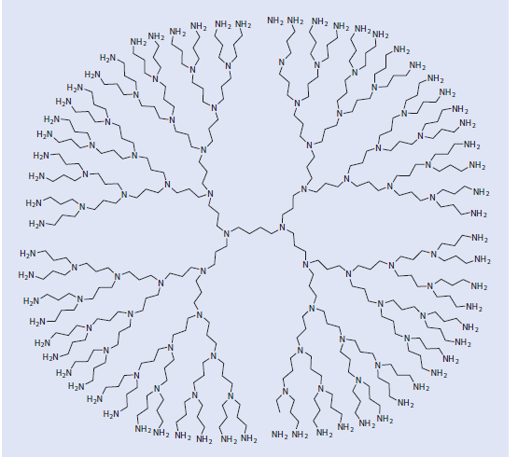
Fig. 2. Schematic representation of a dendrimer

Slide 6
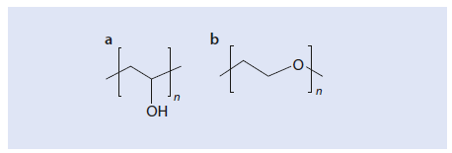
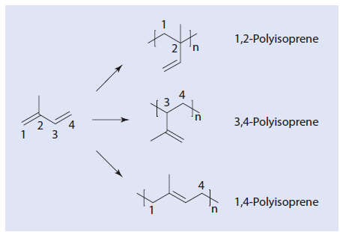
Isomerization in Polymers
Fig. 3. Structural isomerism using the example
of (a) polyvinyl alcohol and(b) polyethylene glycol
Fig. 4. Structural Isomers of polyisoprene

Slide 7
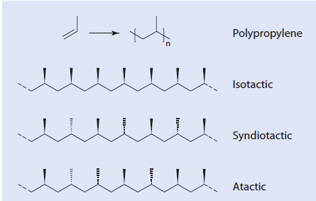
Stereo isomers
Fig.5 .cis-1,4-polybutadiene and trans-1,4-polybutadiene
Fig.6. polypropylene: isotactic,syndotactic, and atactic polymers

Slide 8
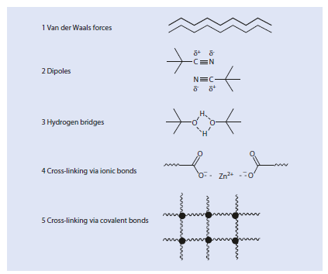
Intermolecular Interaction between polymer chains
Fig.7. Intermolecular Interaction

Slide 9
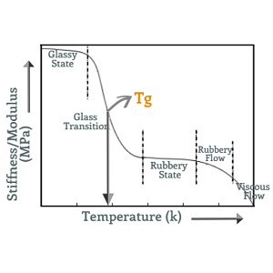
Glass Transition Temp. of Polymers

Slide 10
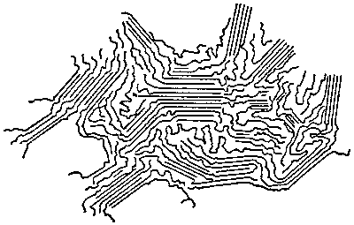
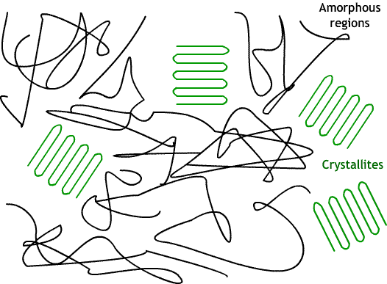
Crystallinity of Polymers
Fig.8. Crystalline-Amorphose polymers

Slide 11
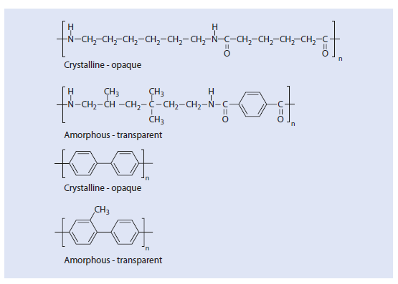
Examples

Slide 12
Examples

Slide 13
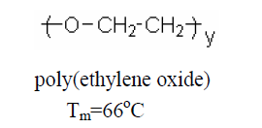
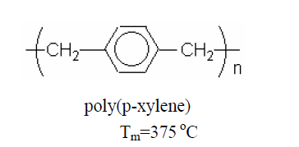
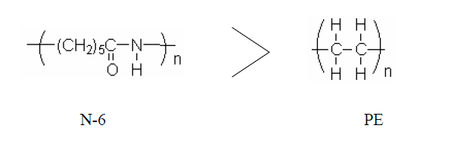
Crystalline Melting Temp. of Polymers

Slide 14
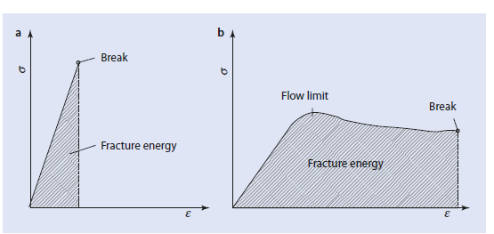
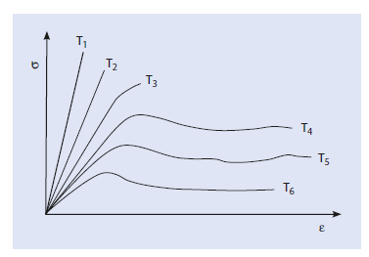
Mechanical Properties of Polymers
Fig.9. Stress-Strain Curve of brittle and elastic polymers
Fig.10. Effect of temp. on the stress-strain curves

Slide 15
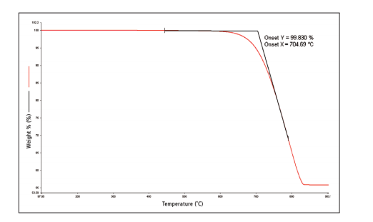
Thermal properties of Polymers

Slide 16
elastomeric materials can be classified into:
• Thermoset Elastomers - are those elastomer materials which do not melt when heated.
• Thermoplastic Elastomers - are those elastomers which melt when heated.

Slide 17
Network Synthesis
1- Reactions of epoxides
2- Reactions of isocyanates
3- Hydrolysis and condensation of alkoxy silanes and hydrosilylation
4- Reactions of phenol and formaldehyde
5- Reactions of urea, thiourea, and melamine with formaldehyde
6- Addition of SH- or NH2-terminated molecules to C=C-bonds
7- Vulcanization of rubber by sulfur, peroxides, or phenol-formaldehyde resins
8- Radical copolymerization of poly-unsaturated monomers

Slide 18
Examples of applications for covalent networks include:
1- Vulcanized rubbers (elastomers, for example car tires)
2- Composite materials
3- Organic coatings, such as car paints
4- Separation media (ion exchange resins)
5- Prostheses, contact lenses
6- Carriers for the controlled release of active ingredients
7- Electronic systems for printed circuits
8- Biological gels, for example the lens of human eyes
Polymer Additives
Improve the processability of the polymer
1- Improve the mechanical properties of the polymer
2- Reduce the costs
3- Modify the surface of the polymer
4- Influence the optical characteristics
5- Improve the aging resistance of the polymer

Slide 19
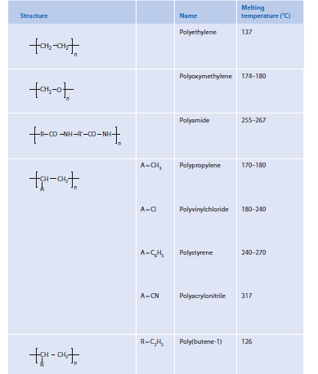
Effect of Polymer Structure on the Melting Temp.

Slide 20
Thank you for your attention
Dr.Widad.Saleh.Hanoosh

